Slide 1



Whose Knowledge? Patterns of Committee Witnesses in the Spanish Congress of Deputies
Ewan Robertson (Ewan.Robertson@ed.ac.uk)
School of Social and Political Science, University of Edinburgh
SKAPE, University of Edinburgh, 23rd April 2025

Slide 2
Introduction – Researching Knowledge and Parliaments
Today: presentation on the characteristics of witnesses invited to committees and the topics they discuss in the Spanish Congress of Deputies.
Context: part of Studying Parliaments and the Role of Knowledge (SPARK), running 2024 – 2029.
  Project examines how parliaments gather, use and interpret knowledge, and the impact of these practices on their democratic functions.

Slide 3
Committees, parliaments and democracy
Parliaments are central democratic institutions, undertaking oversight, legislative and representative functions.
Committees are crucial to each of these areas – enabling a parliamentary division of labour and for MPs to specialise (Oñate and Aldeguer 2021)
Committees also gather knowledge and inform policy, both directly and indirectly (Palau and Rodilla 2022; Benton and Russell 2013)

Slide 4




Oral Evidence and Committees
Gathering oral evidence (OE) is central to committees’ work: (1)
    Scrutiny: hearings enable MPs to better scrutinse gvt and public affairs.
    Expertise: builds specialist knowledge of MPs and parliamentary institutions.
    - e.g. research/technical, lived experience, political/legal.
    Representation : gives a voice to diverse groups and interests.
    Influence: hearings offer a ‘privileged arena’ for external actors.
(1) Points drawn from Geddes 2018.

Slide 5
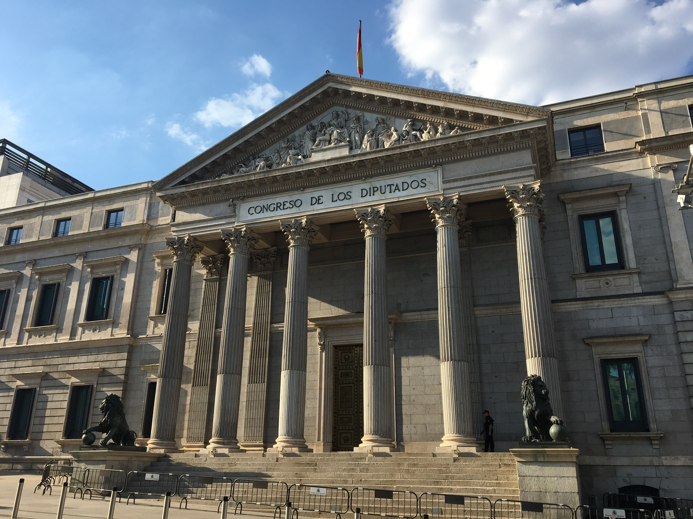
Studying Committee Witnesses in Spain’s Congress of Deputies (CoD)
CoD is the lower house in a bi-cameral parliament.
Witness hearings are a comparatively privileged and scarce knowledge input :
  Committees do not gather written evidence.
  Comparatively few witness invites (vs. UK/Sco).
Thus oral evidence is the main formal way Congress of Deputies committees proactively gather knowledge from external voices.

Slide 6
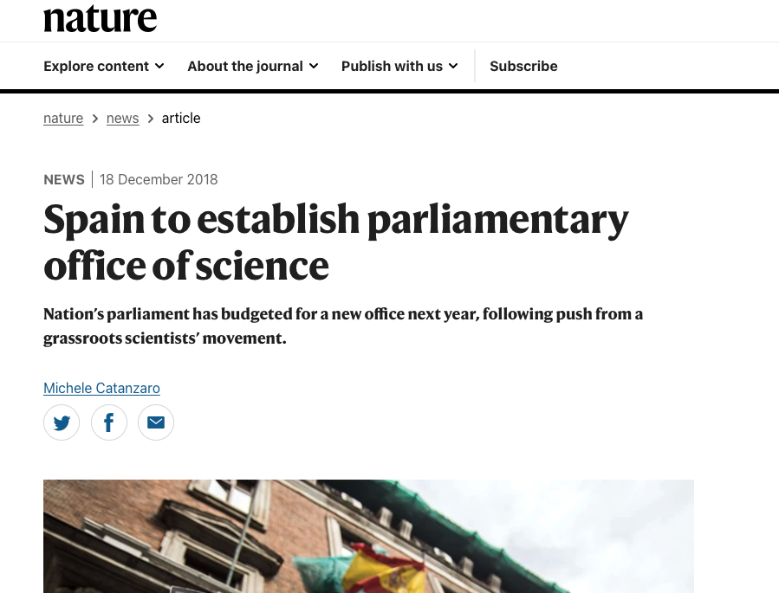
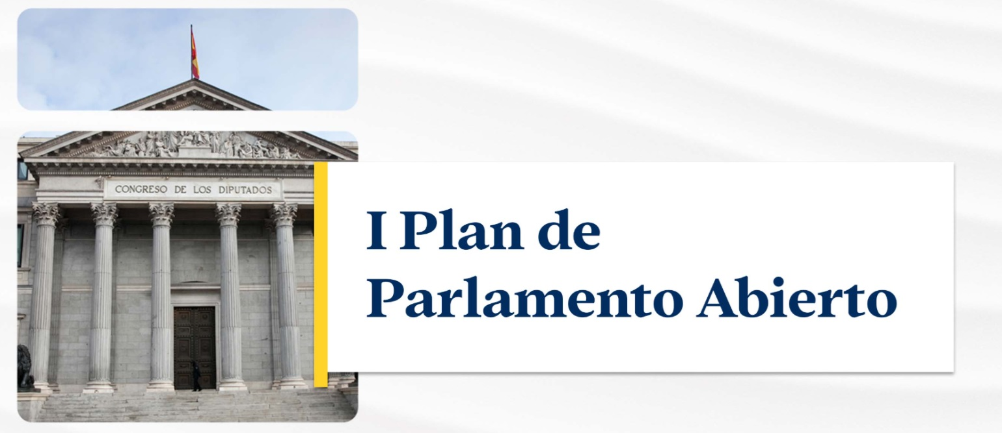
Increasing Focus on Advice and Engagement in Spain’s Parliament
Creation of the Oficina C (2021)
Experiments with public consultations (2020-)
Open Parliament Plan (March 2025):
  Committee to “study tools that facilitate the action of civil society in Parliament”(1)
(1) BOCG, Congreso de los Diputados, serie D, núm. 310, de 26 de marzo de 2025

Slide 7
Congress of Deputies committees: form and function
Four types: legislative, non-legislative, joint, and inquiry.
  Strong formal scrutiny and legislative powers. (1)
  Many members, but subcommittees routinely used (2)
  Run by MPs and supported by a parliamentary clerk (letrado/letrada)
  Committee activity largely controlled by PPGs (low MP autonomy)
  Party groups decide witness invites.
(1) Oñate and Aldeguer 2021; (2) Oñate and Ortega 2019: 396.

Slide 8
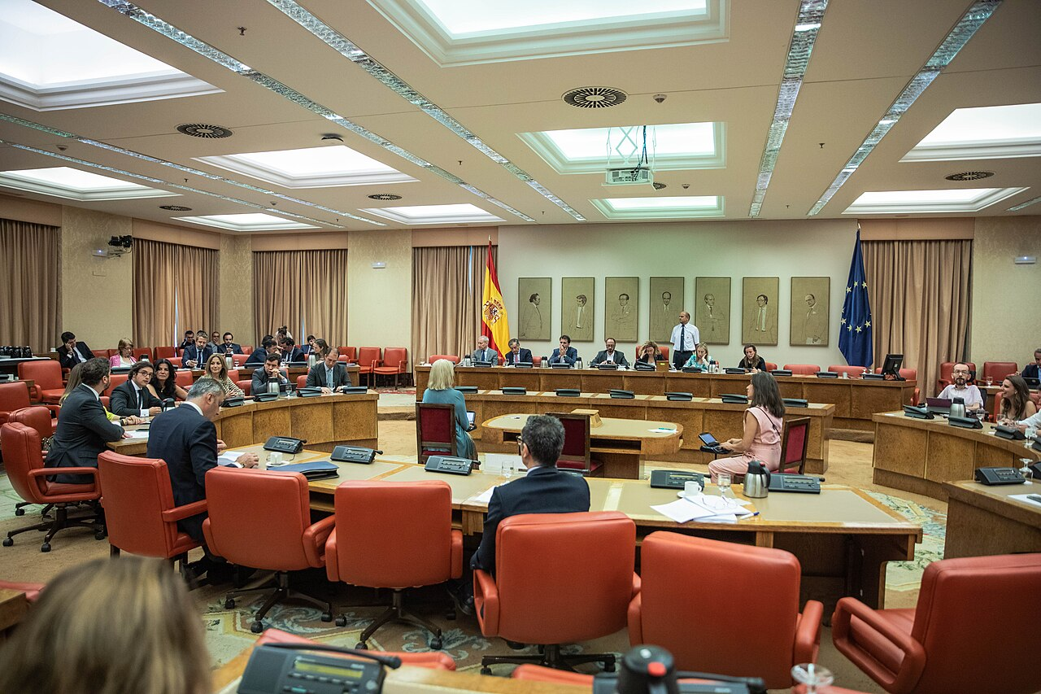
Role of Oral Evidence Hearings
Notes:
Image (1) Sala Constitucional del Congreso de los Diputados. Vox Congreso / Flickr / Wikipedia CCO

Slide 9
What do we know about witnesses on Spanish parliament committees?
Large majority are governmental or public officials (1)
A small minority are invited to directly discuss legislative bills (2)
Increased interest group invites associated with: committee capacity, legislation type & saliency, and presence of minority gvt (for oversight hearings) (3)
Differential logics behind witness invites: (4)
  (i) interest groups: problem-solving (re bills) or partisan conflict (re gvt oversight), (ii) public officials: oversight/technical.
  (1) Oñate and Aldeguer 2021. (2) Palau and Rodilla 2022. (3) Chaqués-Bonafont and Muñoz (2016) (4) Palau and Rodilla 2022; Chaqués-Bonafont and Muñoz 2016.

Slide 10
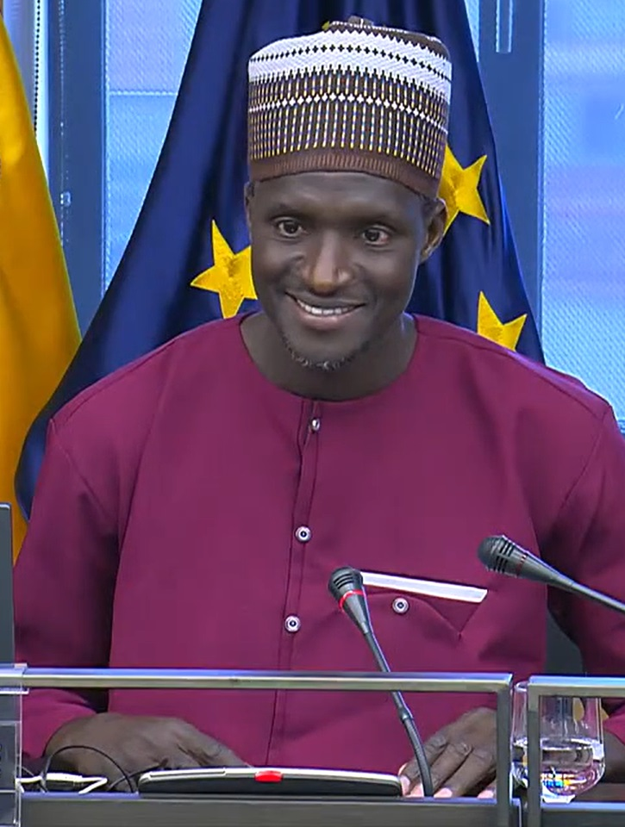
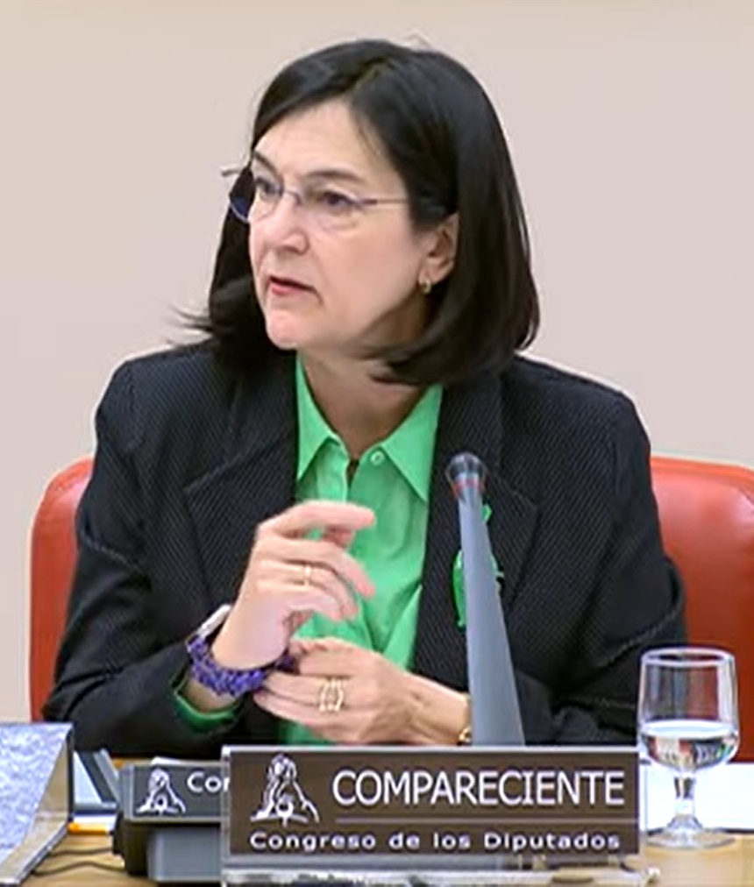
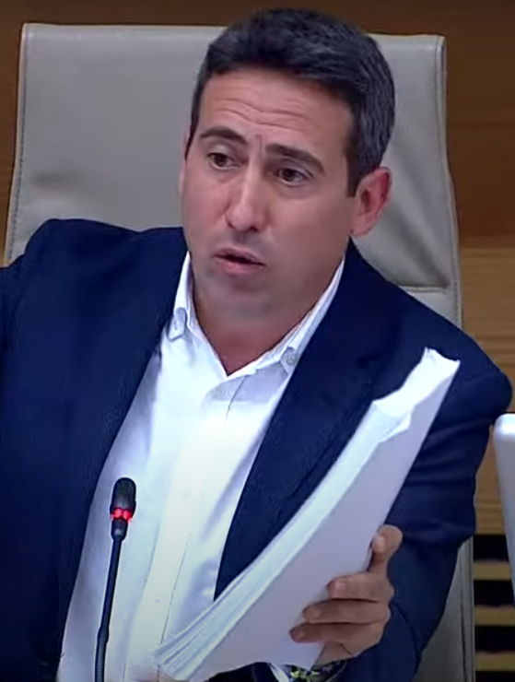
Research Question and Methods
RQs:
  What are the characteristics of invited witnesses?
  What policy topics are they invited to discuss?
Data
  All committees for the 2024 session (44 committees*, n= 357)
  Coding scheme focuses on organisation, gender, geography (Geddes scheme) and topic (Comparative Agendas Project)
  Context: period of left-wing minority government (PSOE & SUMAR) with 9 party groups in parliament.
  *Includes 5 sub-committees formed within main committees.
Notes:
Image descriptions and sources:
La Comisión de Trabajo, Inclusión, Seguridad Social y Migraciones acoge la comparecencia de Mamadou Lamine Sarr, representante de la Comisión Promotora de la Proposición de Ley para una regularización extraordinaria para personas extranjeras en España
La presidenta de la CNMC, Cani Fernández, comparece ante la Comisión de Economía, Comercio y Transformación Digital. YouTube / Canal del Congreso de los Diputados
Comparece Óscar Liria Sánchez, exvicepresidente de la Diputación de Almería, ante la Comisión de Investigación sobre la contratación durante la pandemia de COVID-19. 30/04/2024. Youtube / Congreso de los Diputados.

Slide 12
Organisation type (2024, all committees)

Slide 13
Witness Share vs Regional Population (2024, excl gvt & civil service)

Slide 14
Gender (2024, all committees)

Slide 15
Committee Hearing Type

Slide 16
Main policy topic of invite (proportion of total)

Slide 17
Summary and implications
Concentration of witnesses from government/state organisations and the capital region (Madrid), as well as a 60/40 gender imbalance.
Dominance of ‘oversight’ over ‘informational’ logic of witness hearings.
Amid efforts to increase society’s engagement with parliament, a gap exists between the profile of invited witnesses and the wider population.
Reliance on ‘official’ sources matches executive’s practices (Cañibano and Real Dato 2023) and could exacerbate executive-parliament asymmetries.

Slide 18
(Potential) next steps
More data-gathering to check trends identified.
More fine-grained exploration with respect to particular committees/topics and witness characteristics (e.g. gender)
Comparison with other parliaments, including that of Catalonia.
Use of mixed methods and case studies to open the ‘black box’ of how witness knowledge is used by MPs and committees.
Q: what more should be examined or poses a puzzle to explore?

Slide 19
Thank you
Thank you for listening – feedback appreciated!
Funding acknowledgement:
  Selected for funding from the European Research Council
  Funded by UKRI Frontier Research Guarantee (ref.: EP/Y036271/1)
Find out more about SPARK: https://www.project-spark.net/

Slide 20
Bibliography
Benton, M. and Russell, M. (2013) ‘Assessing the Impact of Parliamentary Oversight Committees: The Select Committees in the British House of Commons’, Parliamentary Affairs, 66, 772–797
Chaqués-Bonafont, L., and Muñoz, L. (2016). Explaining interest group access to parliamentary committees. West European Politics, 39(6), 1276–1298.
Cañibano, C. and Real-Dato, J. (2023). El ecosistema de asesoramiento científico y técnico a las políticas públicas en España. Melchor, L., y Krieger, K. (eds.). Oficina de Publicaciones de la Unión Europea, Luxemburgo.
Congreso de los Diputados (2025). I Plan de Parlamento Abierto del Congreso de los Diputados (2025-2027). BOCG, serie D, núm. 310, de 26 de marzo de 2025
Geddes, M. (2018) Committee Hearings of the UK Parliament: Who gives Evidence and does this Matter? Parliamentary affairs. 71 (2), 283–304.
Geddes, M. (2020) Dramas at Westminster: Select committees and the quest for accountability. Manchester University Press.
Leston-Bandeira, C. and Siefken, S. (2023) ‘The development of public engagement as a core institutional role for parliaments’. The Journal of Legislative Studies 29(3): 361-379.
Oñate, P., and Aldeguer, B. (2021). Committees in a party-dominated parliament: The Spanish Congreso de los Diputados. In: Siefken, S. and Rommetvedt, H. (eds.), Parliamentary Committees in the Policy Process. Routledge, 244–262
Oñate, P., and Ortega, C. (2019). Committee Parliamentary Specialization Index. Explaining MPs’ specialisation in the Spanish Congreso de los Diputados. The Journal of Legislative Studies, 25(3), 394–408.
Palau, A., and Rodilla, A. (2022). Parliamentary committees as policy analysis institutions. In: Chaqués-Bonafont, L. and Jordana, J. (eds.) Policy Analysis in Spain. Policy Press, 141-164.

